Slide 1
The Treaty of Versailles:
Setting the Table for World War II

Slide 2
Copyright Notice
Certain materials in this presentation are included under the fair use exemption of the U.S. Copyright Law and have been prepared with the multimedia fair use guidelines and are restricted from further use.

Slide 3
January 8, 1918: Wilson’s Fourteen Points
At the time, Germany thought it still had a chance, so did not reply.
October 3, 1918, Germany and Austria-Hungary appeal directly to Wilson, fearing rejection and invasion at the hands of the other Allied Powers.
Allied response: Second point must be eliminated, Germany must make compensation
Germany presented surrender terms on 11/08/1918, given 72 hours to accept or reject
Armistice declared 11th hour of 11/11/1918.

Slide 4
The Treaty Room at Versailles

Slide 5
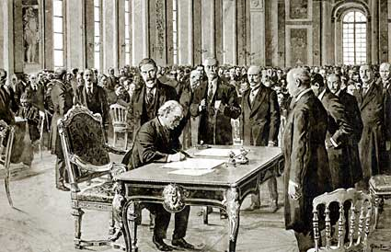
June 28th, 1919

Slide 6
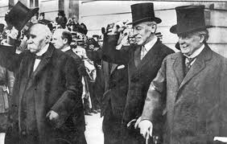
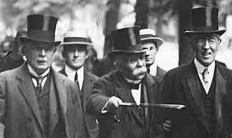
Wilson, George, Clemenceau
When asked how he thought he had done at the Versailles Conference, Lloyd George replied:
"Not badly, considering I was seated between Jesus Christ and Napoleon."

Slide 7
Ends and Aims
Georges “The Punisher” Clemenceau
Woodrow “The Peacemaker” Wilson
Lloyd “The Political Pragmatist” George

Slide 8
A Complex Document
58 committees and commissions
1, 600 meetings
15 parts
440 articles
Scores of annexes

Slide 9
Germans not allowed to attend the talks – “Sign, or else!”

Slide 10
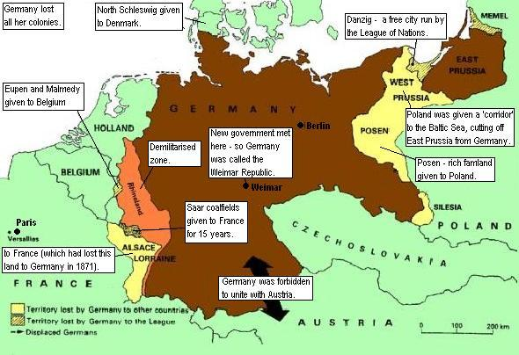
Redrawing Europe

Slide 11
Terms of the Treaty
Alsace-Lorraine given to France, Eupen and Malmedy to Belgium

Slide 12
Terms of the Treaty
Poland created and given West Prussia to create a “Polish Corridor” to the sea.

Slide 13
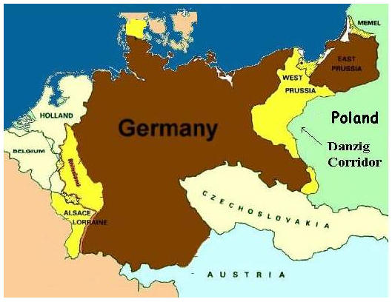
Terms of the Treaty
Danzig to be an international city run by the Leaugue of Nations

Slide 14
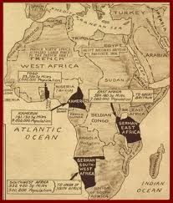
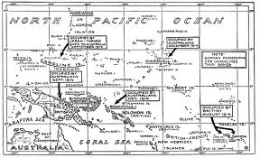
Terms of the Treaty
All German colonies surrendered to the allies

Slide 15
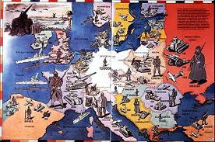
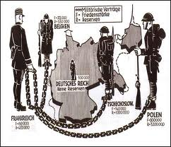
Terms of the Treaty
German army reduced to 100, 000

Slide 16
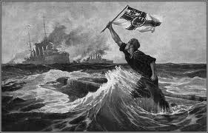
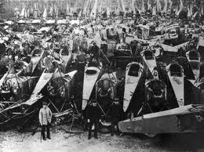
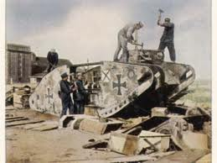
Terms of the Treaty
Germans allowed no tanks, air force, or submarines

Slide 17
Terms of the Treaty
Warships limited to 10,000 tons

Slide 18
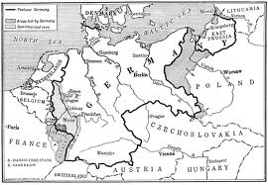
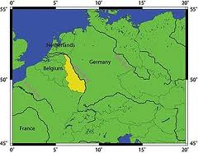
Terms of the Treaty
The Rhineland to be occupied for fifteen years and then permanently demilitarised – no German troops

Slide 19
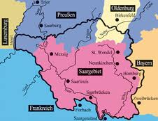
Terms of the Treaty
The Saar coalfields were to be given to France for 15 years after which there would be a vote to see if they wished to be German or French

Slide 20
Terms of the Treaty
Article 231: Germany forced to accept sole responsibility for the outbreak of the war
Notes:
Germanie Geketend.

Slide 21
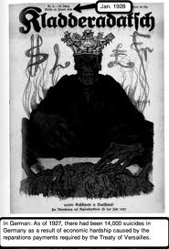
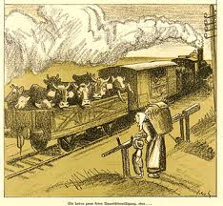
Terms of the Treaty
Germany had to pay damages to France, Belgium, the UK and other countries

Slide 22
Terms of the Treaty
Germany and Austria were never to be allowed to unite

Slide 23
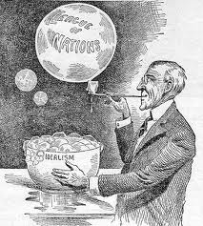
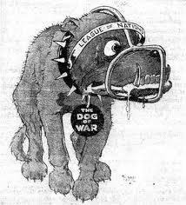
Terms of the Treaty
A League of Nations was to be created

Slide 24
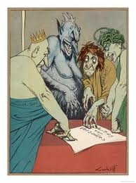
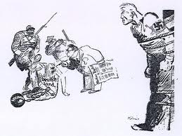
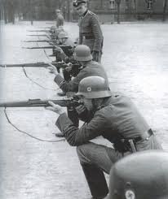
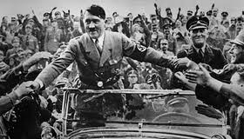
German Reaction

Slide 25
Works Cited
“The Treaty of Versailles I”. http:www.historyman.co.uk/ww1/Peace1.html. 3 Feb 2011. Online.
Vaughan,Hharold Cecil. The Versailles Treaty: 1919 Germany’s Formal Surrender at the End of the Great War. New York: 1975, Franklin Watts Inc. Print.

