Slide 1
The Rise of Labor Unions
The need for reform grows

Slide 2
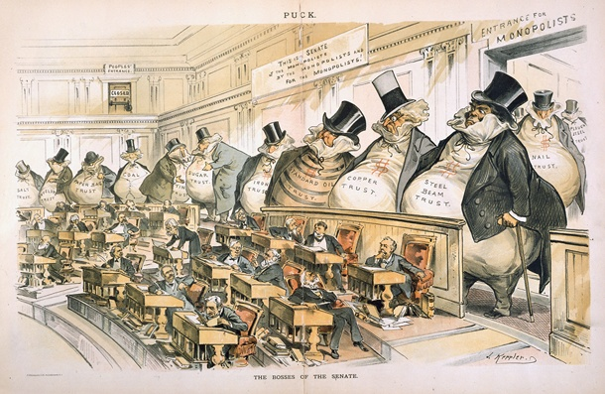

Slide 3
Bell Ringer:
Name 3 of the “robber barons” (industrialists) we discussed last class and the industry they were in.
What is a monopoly? What are some negative effects of monopolies?
What was Laissez-faire capitalism?

Slide 4
Faces of Lost Youth
The Pictures of Lewis Hine
http://www.historyplace.com/unitedstates/childlabor/

Slide 5
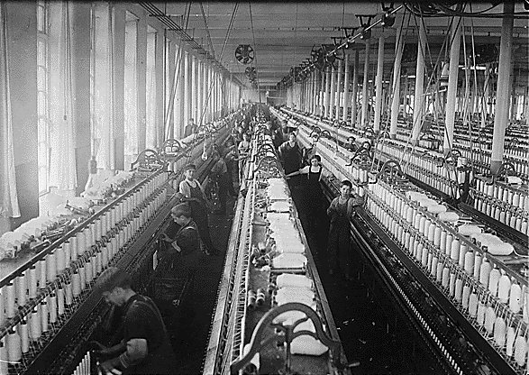

Slide 6
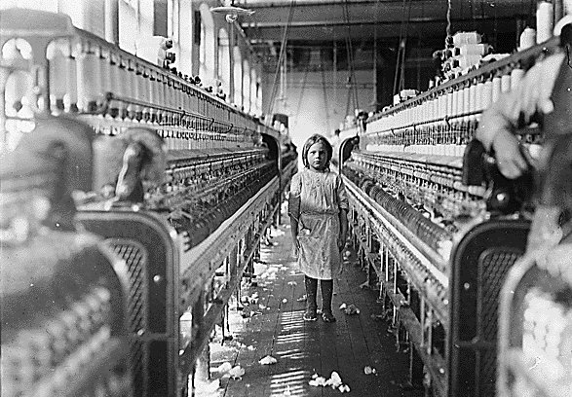

Slide 7
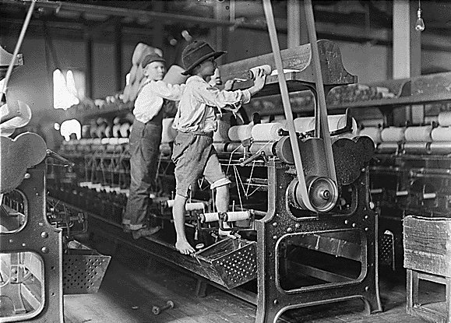

Slide 8
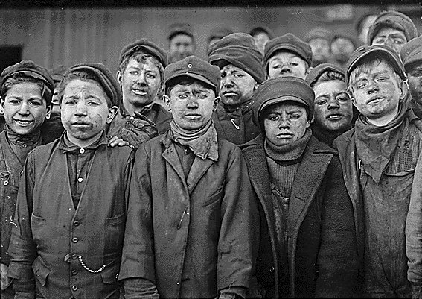

Slide 9
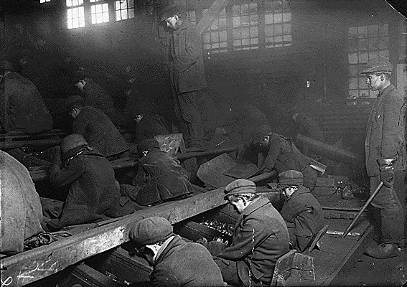

Slide 10
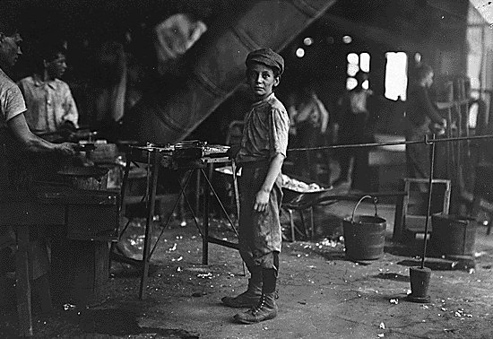

Slide 11
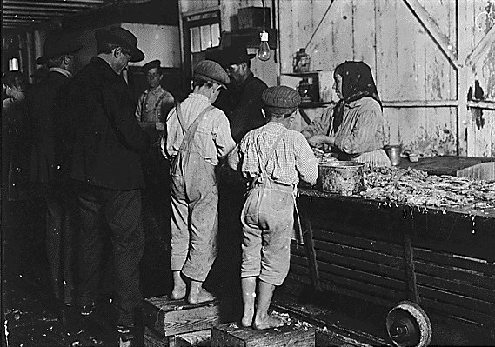

Slide 12
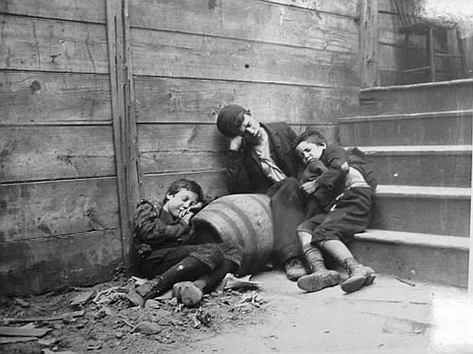
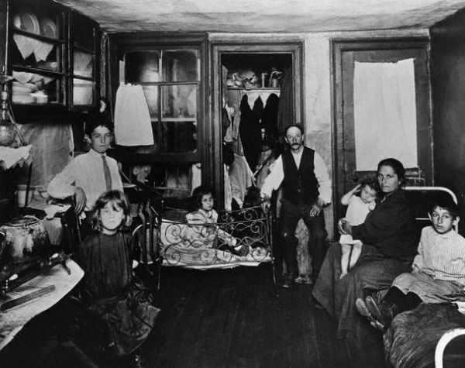
Other Images, by Jacob Riis

Slide 13
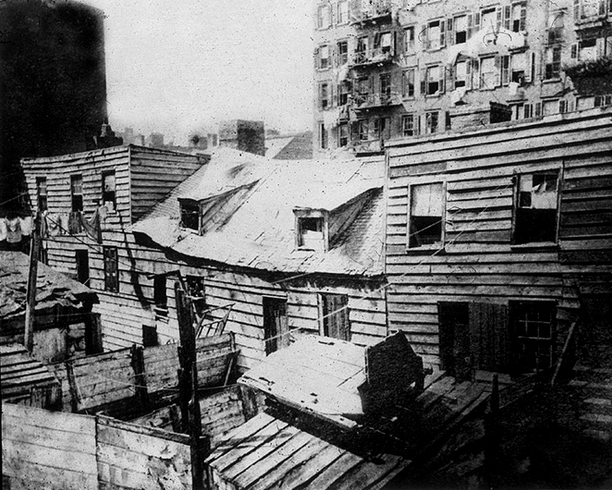
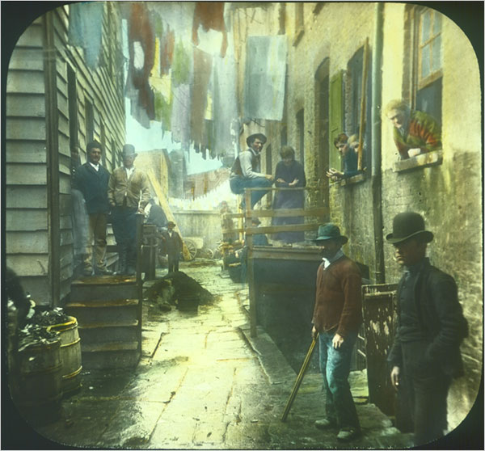

Slide 14
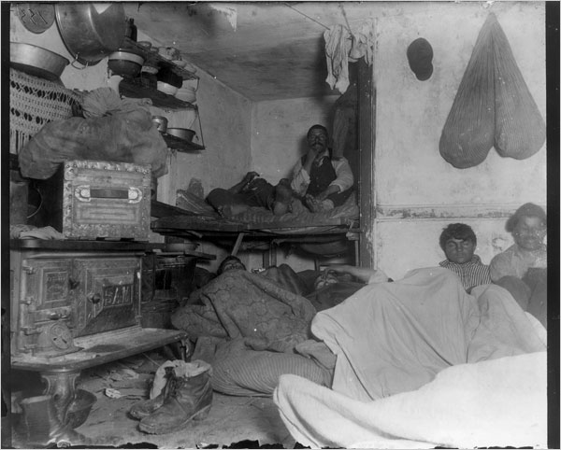

Slide 15
Problems:
Working conditions:
  Dangerous
    Heavy machinery
    Dangerous conditions in mines, construction etc.
    Hot and unsanitary
  Long hours, low wages, no job security, no worker’s benefits (example: healthcare, paid holidays, paid maternity leave).
  Company towns
    often workers had to live in homes provided by factory owners.
    Homes were often more expensive to rent than outside housing
    Homes were often in poor condition
  Child labor, immigrant labor, and employment of women = lower wages

Slide 16
Why did Labor Unions form?
Labor unions formed to fight for better working conditions, treatment, and pay

Slide 17
Beliefs of Labor Unions
Opposed unrestricted immigration
  Immigration = cheap labor
Refused women and African-Americans as members
Supported free compulsory education
  Remove child labor from the workforce
Notes:
17

Slide 18
Struggles and Conflict
1881-1900 – 24,000 strikes in the US
many blamed labor unrest on infiltration of socialists and anarchists
Notes:
18

Slide 19
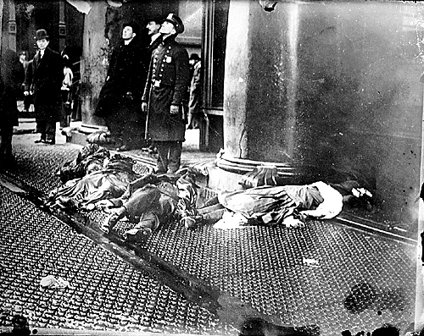
Triangle Shirtwaist Factory Fire
March 25th, 1911

Slide 20
After the Triangle Shirtwaist Factory Fire the International Ladies Garment Workers Union, was formed.
Successes:
  Brought aid to families of victims of the fire
  Modern factory inspection system established
  Laws to regulate the labor of women, children and safety regulations established

Slide 21
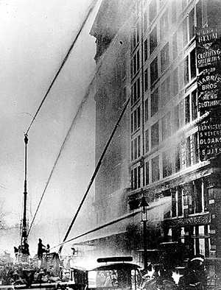
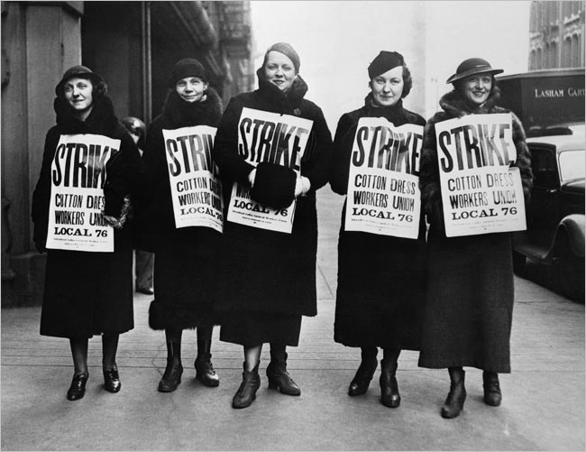
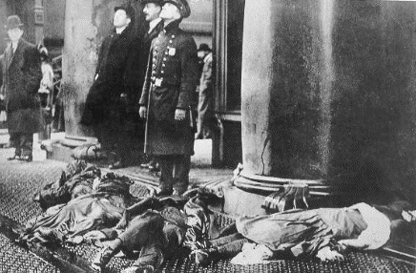

Slide 22
Knights of Labor
  Founder: Uriah Stevens and Terrance V. Powderly
  What they wanted: 8 hour workday, higher wages
  Who could join: skilled and unskilled workers
  Methods they used: strikes
  Declined by 1886
  Safari Montage, “A Nation in Turmoil” chaps 5-7 (~8 minutes)

Slide 23
Haymarket Square Riot - 1886
Knights of Labor led a strike for 8 hour work day
A bomb was thrown during the protest meeting held by striker and the police were called in.
Impact:
  Knights of Labor are identified as anarchists and associated with violence
  American public turned against them, and against labor unions in general

Slide 24
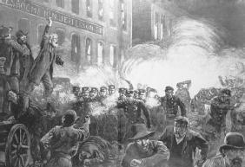
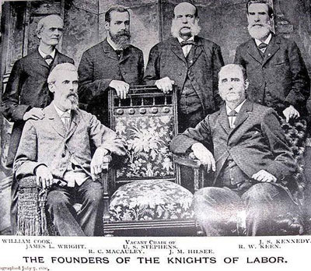

Slide 25
The American Federation of Labor 1881
Founder: Samuel Gompers
What they wanted: 8 hour work day, improved working conditions, higher wages
Who could joined: different skilled craft workers
Methods used: Strikes and Boycotts
Successes:
  won the closed shop (where factories could only hire union workers)
  Abolished yellow-dog contracts (companies had required workers to sign contracts promising NOT to join a union)
Notes:
Cigar makers, blacksmiths, shoe makers etc.

Slide 26
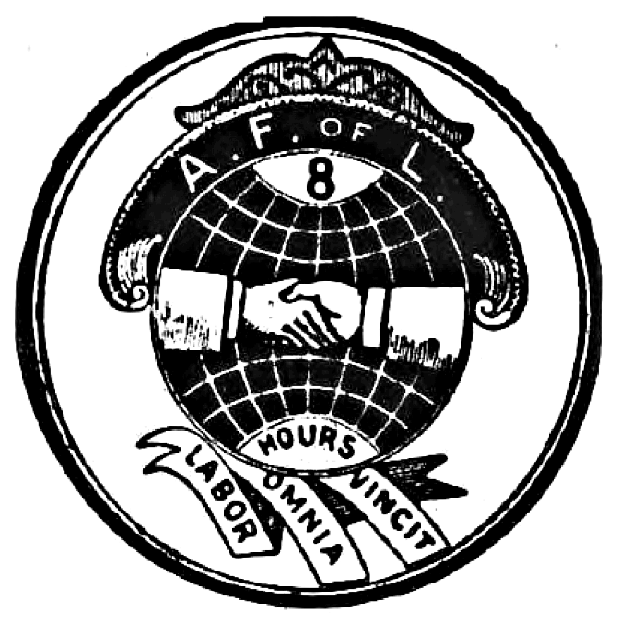

Slide 27
Homestead Strike - 1892
Carnegie Steel Company threatened to cut wages
Workers picketed and management called in the Pinkerton Guards. Violence erupted.
Strike lasted 9 months. President of Carnegie Steel shot in the neck.
Public opinion turned against on the protesters.
Workers returned to work on the company’s terms.

Slide 28
American Railway Union
Founder Eugene V. Debs
What they wanted: 8 hour work day, improved working conditions, higher wages
Who could join: skilled and unskilled workers
Won a major striker for better wages but lost another major strike and ended up struggling for members.

Slide 29
Pullman Strike 1894
Pullman Palace (Rail) Car Company had cut wages
Strike spread and brought railroad traffic west of Chicago to a standstill
Strikers received help from Eugene V. Debs and American Railway Union
President Cleveland sent troops and Supreme Court obtained a court injunction to stop the strike.
  Why? Court said the federal government may intercede when interstate commerce is affected.

Slide 30
Exit Ticket (Review):
What was the Sherman Anti-Trust Act supposed to do?
Name one new invention that made life easier after the Civil War.
Name two reasons why labor unions were mostly unsuccessful in reaching their goals in this time period:

