Slide 1
Roosevelt’s New Deal: 1933 - 1935
How FDR Changed America

Slide 2
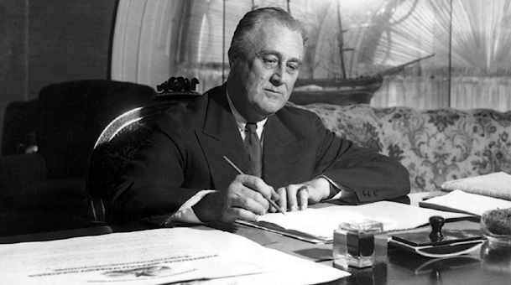
First New Deal: 1933 - 1935

Slide 3
The Three R’s
Relief
Civilian Conservation Corps (CCC)
Works Progress Administration (WPA)

Slide 4
The Three R’s
Reform
Programmatic government
drastically altered the relationship between the capitalist market, the people, and their government
created for the first time in this country's history an activist state committed to providing individual citizens with a measure of security against the unpredictable turns of the market.
Permanently changed Americans’ expectations for the presidency

Slide 5
The Three R’s
Recovery
GDP would not reach 1929 level until 1941
Unemployment remained high: peaked around 25% when FDR took office, remained above 20% through 1935, did not drop below 14% until 1941
Radicalism:
Huey Long – Massive redistribution of wealth
Dr. Frances Townsend – Massive pension plan
Upton Sinclair – Farm collectivization in California
Communist organization

Slide 6
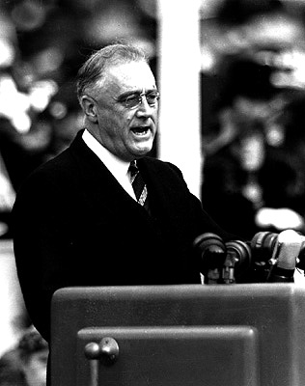

Slide 7
The First One Hundred Days
Special Session of Congress called on March 9, 1933
Banking Bill
Slashed government spending by cutting half a billion dollars in scheduled payments to veterans and federal employees.
Ended Prohibition by legalizing the sale of beer and wine
Agricultural Adjustment Act: Farm price supports, America taken off of the gold standard
Civilian Conservation Corps: Provided jobs in the forestry industry

Slide 8
The First One Hundred Days
Tennessee Valley Authority: Dams, irrigation, electricity
Home Owners Loan Corporation: helps homeowners to avoid foreclosure
Federal Emergency Relief Corporation: provided funds to states to assist people with emergency food, shelter, etc.
Glass-Steagall Banking Act: Created “firewall” between investment and commercial banking, empowered the federal government to regulate Wall Street
Federal Deposit Insurance Corporation: insured bank deposits, ended bank failures

Slide 9
The First One Hundred Days
National Industrial Recovery Act:
Created the Public Works Administration
Created the Civil Works Administration
Guaranteed labor the right to organize
Created the National Recovery Administration

Slide 10
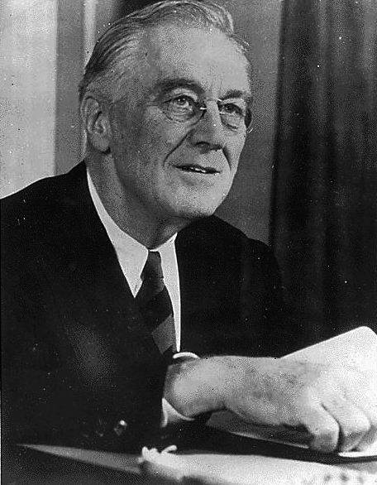
The Second New Deal: 1935
The “Second One Hundred Days”

Slide 11
Second New Deal Reforms
Wagner National Labor Relations Act: Guarantees the right of workers to form unions
Emergency Relief Appropriations Bill: Expands funding for Works Progress Administration
Social Security Act
“Wealth Tax” Reform: Raised marginal tax rates, “stole the thunder” from Huey Long

Slide 12
Outcomes

Slide 13
Summary
New Deal legislation provided, for the first time, government protection of the rights of workers to organize unions, allowing the unionized population to skyrocket from 11% of the workforce in 1930 to an all-time high of 35% in 1945. The labor vote has been heavily Democratic ever since.

Slide 14
Summary
Roosevelt's measures to prop up farmers were far from perfect, but they still went farther than any previous president had gone to address agricultural grievances that dated back to the nineteenth century.

Slide 15
Summary: New Deal Politics
Roosevelt's 1932 victory was due more to disgust with Hoover than to enthusiasm for the Democratic program. Through the implementation of the New Deal, FDR was able to construct a new political coalition that created a solid Democratic majority that would endure for a generation.

Slide 16
Summary: New Deal Partners & Beneficiaries
The New Deal coalition included:
The "Solid South" of traditionalist Southern whites Democrats; their leverage caused the failure of progressive measures to benefit African-Americans
Trade unionists
Farmers
City-dwellers
Minorities
Liberal intellectuals

