Slide 1
Racism in the Late 19th and Early 20th Century: “The Negro Problem” and Black Solutions
Henry B. Stobbs, MFA

Slide 2
The Appearance of Progress
1865- End of the Civil War
Federal troops maintain rule of law
1865 – 13th Amendment ends slavery
1868 – 14th Amendment makes Blacks equal to Whites before the law
1870 – 15th Amendment guarantees voting rights for Blacks
1875 – Civil Rights Act guarantees equal treatment in public accommodations

Slide 3
Abolitionists win the war, but lose the peace
1877 – “Death” of Reconstruction – the “Great Betrayal” in the Compromise of 1877
1883 – Supreme Court declares the 1875 Civil Rights Act unconstitutional
1880s – series of racially discriminatory Black Codes – “Jim Crow” laws enacted across the South (they existed in the North too, before the Civil War, and after!)
1890 – Louisiana implements segregation in public transportation
1898 – Plessy v. Ferguson fundamentally enshrines institutional racism in the Constitution

Slide 4
“How does it feel to be a problem?”
“The Negro Problem”
Racial Darwinism
Racial Segregation
Racial Exclusion
Racial Disenfranchisement
Elimination from the political sphere
Racial terrorism – threats, intimidation, lynching

Slide 5
The United States of America: A Foreign Country
“The USA of a century ago – a time and place where extreme cultural assumptions about racial difference enabled extreme and brutal practices of social repression.”
Kevin G. Gaines, Professor of History, U of M.

Slide 6
The Black Response
Radicals – advocated protests and agitation against lynching and disenfranchisement
Conservatives – accommodation, self-help, pursuit of property ownership
Some favored industrial education
Some favored higher education
Alliances formed with progressive whites
Black migration - the “Exodusters” leave for freer ground

Slide 7
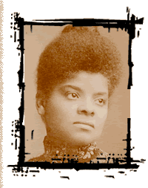
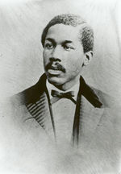
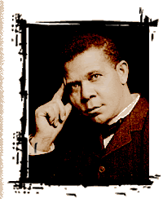
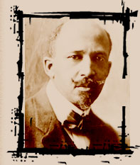
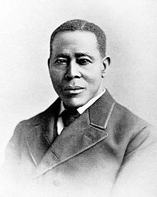
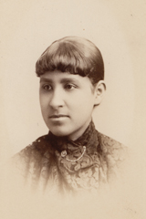
Leaders and Martyrs
Notes:
L 2 R: Wells, Octavius Catto, Washington, DuBois, William Still, Terrell

Slide 8
Extra Credit Opportunity
Who are Octavius Catto and William Still? Why are they included among the “stars” of resistance to White racism and repression of Black civil rights?
Prepare a 3 x 5 card, with header on one side and response on the other, for one, or both (separate cards) of these men and turn it in for up to three points each.

